Slide 1
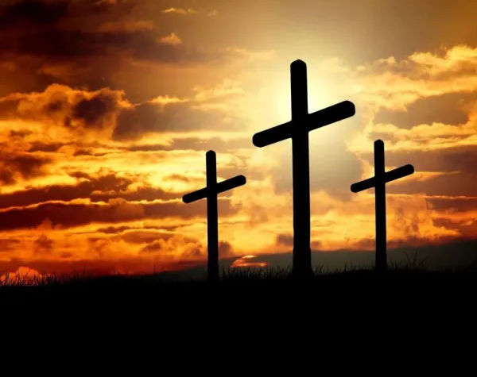
Hosanna (Praise Is Rising)

Slide 2
G C
Praise is rising, eyes are turning to You
G
We turn to You
G C
Hope is stirring, hearts are yearning for You
G
We long for You

Slide 3
D
'Cause when we see You
C G
We find strength to face the day
D
And in Your presence
C G
All our fears are washed away
D
washed away

Slide 4
G Em C
Hosanna, hosanna
G D
You are the God who saves us,
Em C
worthy of all our praises
X2 to verse 2

Slide 5
G C
Hear the sound of hearts returning to You
G
We turn to You
G C
In Your kingdom broken lives are made new
G
You make us new

Slide 6
D
'Cause when we see You
C G
We find strength to face the day
D
And in Your presence
C G
All our fears are washed away
D
washed away

Slide 7
G Em C
Hosanna, hosanna
G D
You are the God who saves us,
Em C
worthy of all our praises

Slide 8
G Em C
Hosanna, hosanna
G D
Come have Your way among us
Em C
We welcome You here Lord Jesus

Slide 9
D
'Cause when we see You
C G
We find strength to face the day
D
And in Your presence
C G
All our fears are washed away
D
washed away
x2 to chorus

Slide 10
G Em C
Hosanna, hosanna
G D
You are the God who saves us,
Em C
worthy of all our praises

Slide 11
G Em C
Hosanna, hosanna
G D
Come have Your way among us
Em C
We welcome You here Lord Jesus
play x2

Slide 12

Give Us Clean Hand

Slide 13
G D
We bow our hearts, we bend our knees
C G
Oh Spirit come and make us humble
G D
We turn our eyes from evil things
C
Oh Lord we cast down our idols

Slide 14
G
Give us clean hands
D
Give us pure hearts
Em D G
Let us not lift our souls to another

Slide 15
G
Give us clean hands
D
Give us pure hearts
Em D C
Let us not lift our souls to another

Slide 16
G
O God, let us be
D
A generation that seeks
Em
seeks Your face
D G
O God of Jacob

Slide 17
G
O God, let us be
D
A generation that seeks
Em
seeks Your face
D C
O God of Jacob

Slide 18
G D
We bow our hearts, we bend our knees
C G
Oh Spirit come and make us humble
G D
We turn our eyes from evil things
C
Oh Lord we cast down our idols

Slide 19
G
Give us clean hands
D
Give us pure hearts
Em D G
Let us not lift our souls to another

Slide 20
G
Give us clean hands
D
Give us pure hearts
Em D C
Let us not lift our souls to another

Slide 21
G
O God, let us be
D
A generation that seeks
Em
seeks Your face
D G
O God of Jacob

Slide 22
G
O God, let us be
D
A generation that seeks
Em
seeks Your face
D C
O God of Jacob

Slide 23
Instrumental
G / D / C / G
G / D / C / G

Slide 24
G
Give us clean hands
D
Give us pure hearts
Em D G
Let us not lift our souls to another

Slide 25
G
Give us clean hands
D
Give us pure hearts
Em D C
Let us not lift our souls to another

Slide 26
G
O God, let us be
D
A generation that seeks
Em
seeks Your face
D G
O God of Jacob

Slide 27
G
O God, let us be
D
A generation that seeks
Em
seeks Your face
D C
O God of Jacob x3 and end
END

Slide 28

Eagles Wings

Slide 29
Am / D / G / C
Am / D / G / C
Am D G C
Here I am waiting Abide in me I pray
Am D G
Here I am longing for You
Am D G C
Hide me in Your love, Bring me to my knees
Am D G C D
May I know Jesus more and more

Slide 30
G C
Come live in me
Am D
All my life, take over
G C
Come breathe in me
Am D G
And I will rise on Eagles Wings

Slide 31
Am D G C
Here I am waiting, abide in me I pray
Am D G
Here I am longing for You
Am D G C
Hide me in Your love, bring me to my knees
Am D G C D
May I know Jesus more and more

Slide 32
G C
Come live in me
Am D
All my life, take over
G C
Come breathe in me
Am D G
And I will rise on Eagles Wings
X2 and END

Slide 33
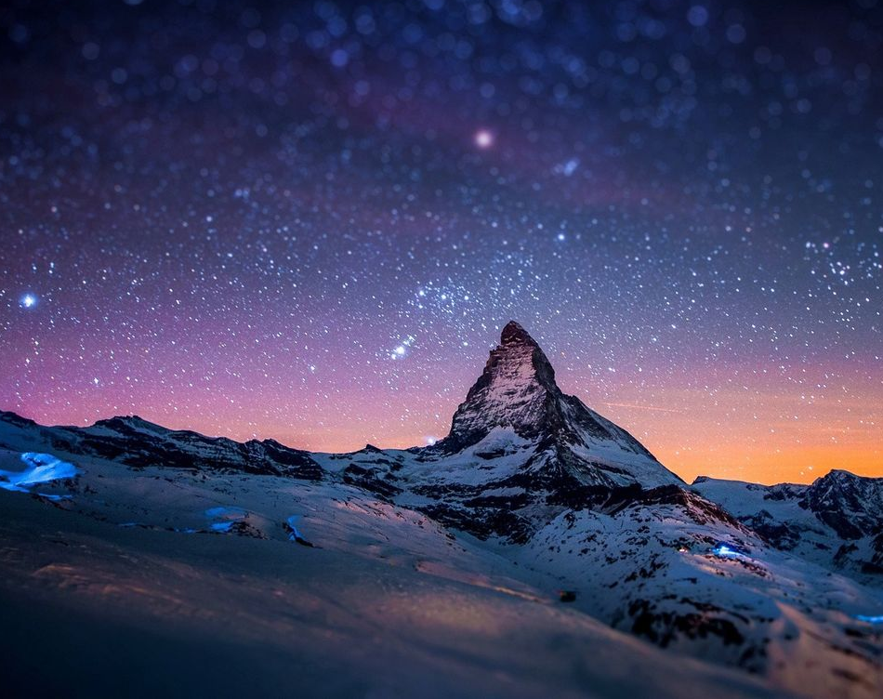
All sufficient merit

Slide 34
CAPO @ 4th
Am G F C F G
All sufficient merit Shining like the sun
Am G F C F G F C
A fortune I inherit By no work I have done
G Am F C
My righteousness I forfeit At my saviors cross
G Am F G C F
Where all sufficient merit Did what I could not

Slide 35
Am G F C F G
In love he condescended Eternal now in time
Am G F C F G C
A life without a blemish The maker made to die
G Am F C
The Law could never save us Our lawlessness had won
G Am F G C
Until the pure and spotless Lamb had finally come

Slide 36
G Am Em
It is done It is finished
F C
No more debt I owe
G
Paid in full
Am Em F G
All sufficient merit now my own

Slide 37
Am G F C F G
I lay down my garments Any empty boast
Am G F C F G C
Good works now all corrupted By the sinful host
G Am
Dressed in my LORD Jesus
F C
A crimson robe made white
G Am F G C
No more fear of judgement His righteousness is mine

Slide 38
G Am Em
It is done It is finished
F C
No more debt I owe
G
Paid in full
Am Em F G
All sufficient merit now my own

Slide 39
Am G F C F G
All sufficient merit Firm in life and death
Am G F C F G C
The joy of my salvation Shall be my final breath
G Am F C
When I stand accepted Before the throne of God
G Am F G C
I’ll gaze upon my Jesus And thank Him for the cross
F G C
Yes I’ll thank Him for the cross

Slide 40
G Am Em
It is done It is finished
F C
No more debt I owe
G
Paid in full
Am Em F G
All sufficient merit now my own
END

Slide 41
In Christ Alone

Slide 42
CAPO at 2nd (D)
F C Am G
In Christ alone my hope is found
C F G C
He is my light, my strength, my song
F C Am G
This cornerstone, this solid ground
C F G C
Firm through the fiercest drought and storm

Slide 43
C F Am G
What heights of love, what depths of peace
C F Am G
When fears are stilled, when strivings cease
F C Am G
My comforter, my all in all
C F G C C
Here in the love of Christ I stand

Slide 44
F C Am G
In Christ alone, who took on flesh
C F G C
Fullness of God in helpless babe
F C Am G
This gift of love and righteousness
C F G C
Scorned by the ones He came to save

Slide 45
C F Am G
'Til on that cross as Jesus died
C F Am G
The wrath of God was satisfied
F C Am G
For every sin on Him was laid
C F G C C
Here in the death of Christ I live

Slide 46
F C Am G
There in the ground His body lay
C F G C
Light of the world by darkness slain
F C Am G
Then bursting forth in glorious day
C F G C
Up from the grave He rose again

Slide 47
C F Am G
And as He stands in vict-ory
C F Am G
Sin's curse has lost its grip on me
F C F G
For I am His and He is mine
C F G C C
Bought with the precious blood of Christ

Slide 48
F C Am G
No guilt of life, no fear in death
C F G C
This is the power of Christ in me
F C. Am G
From life's first cry to final breath
C F G C
Jesus commands my destiny

Slide 49
C F Am G
No power of hell, no scheme of man
C F Am G
Can ever pluck me from His hand
F C Am G
'Til He returns or calls me home
C F G C
Here in the power of Christ I'll stand
X2 & END

